Slide 1
Viruses-
Viroids & Prions
Dr. Sonal Mishra

Slide 2
Viroids & Prions

Slide 3
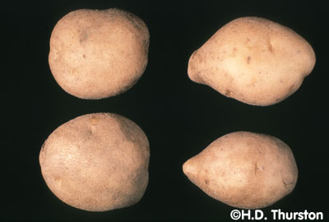
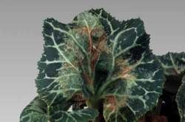
Viroids
Small, circular RNA molecules without a protein coat
Infect plants
Potato famine in Ireland
Resemble introns cut out of eukaryotic

Slide 4
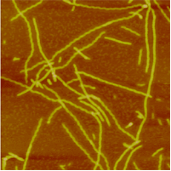
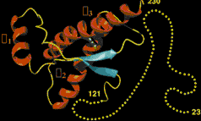
Prions
Prions are “infectious proteins”
They are normal body proteins that get converted into an alternate configuration by contact with other prion proteins
They have no DNA or RNA
The main protein involved in human and mammalian prion diseases is called “PrP”

Slide 5
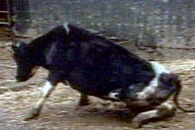
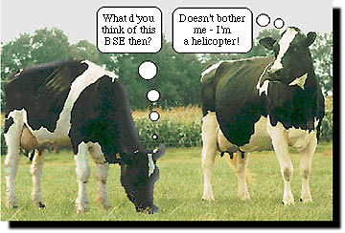
Prion Diseases
Prions form insoluble deposits in the brain
Causes neurons to rapidly degeneration.
Mad cow disease (bovine spongiform encephalitis: BSE) is an example
People in New Guinea used to suffer from kuru, which they got from eating the brains of their enemies

Slide 6


